Slide 1





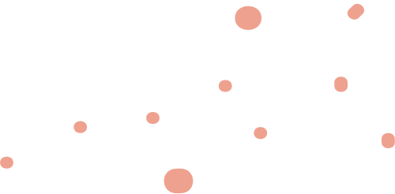



DSD FInal Project
INSTRUCTOR: DR. VO MINH THANH

Slide 2
our team
Trần Minh Phương
Phạm Quang Vinh
Nguyễn Huỳnh Minh Thông

Slide 3
Description
This project aims to design and implement a multi-cycle MIPS (Microprocessor without Interlocked Pipeline Stages) microprocessor using the Verilog Hardware Description Language (HDL) and an Altera FPGA (Field-Programmable Gate Array) development kit. The objective is to develop a fully functional microprocessor capable of executing MIPS instructions, adhering to the multi-cycle architecture.

Slide 4
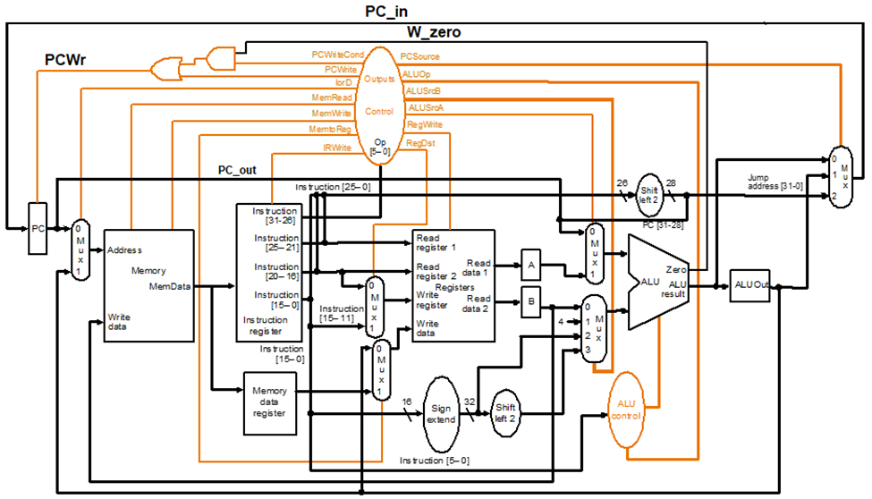

Slide 5
testing assembly
Instruction and Meaning
Begin:
addi $s2, $zero, 0x55 // load immediate value 0x55 to register $s2
addi $s3, $zero, 0x22 // load immediate value 0x22 to register $s3
addi $s5, $zero, 0x77 // load immediate value 0x77 to register $s5
add $s4, $s2, $s3 // $s4 = $s2 + $s3=> R20=0x77
sub $s1, $s2, $s3 // $s1 = $s2 – $s3 => R17=0x22
sw $s1, 0x02($s2) // Memory[$s2+0x02] = $s1
lw $s6, 0x02($s2) // $s6 = Memory[$s2+0x02]
bne $s5, $s4, End // Next instr. is at End if $s5 != $s4
addi $s8, $zero, 0x10 // load immediate value 10 to register $s8
beq $s5,$s4, End // Next instr. is at End if $s7 == $s4
addi $s8, $zero, 0x20 // load immediate value 20 to register $s8
End: j End // jump End

Slide 6
testing assembly
Instruction and Meaning
Begin:
addi $s2, $zero, 0x55 // load immediate value 0x55 to register $s2
addi $s3, $zero, 0x22 // load immediate value 0x22 to register $s3
addi $s5, $zero, 0x77 // load immediate value 0x77 to register $s5
add $s4, $s2, $s3 // $s4 = $s2 + $s3=> R20=0x77
sub $s1, $s2, $s3 // $s1 = $s2 – $s3 => R17=0x22
sw $s1, 0x02($s2) // Memory[$s2+0x02] = $s1
lw $s6, 0x02($s2) // $s6 = Memory[$s2+0x02]
beq $s5,$s4, End // Next instr. is at End if $s7 == $s4
addi $s8, $zero, 0x10 // load immediate value 10 to register $s8
bne $s5, $s4, End // Next instr. is at End if $s5 != $s4
addi $s8, $zero, 0x20 // load immediate value 20 to register $s8
End: j End // jump End

Slide 7
Demo and explanation

Slide 8
Conclusion
The program is a simple multicycle microprocessor that outputs the result via the hex. The input can be easily manipulated using converted MIPS language to binary in the main function, showing what the value where is it, stored it and where it will be stored.

Slide 9
QnA
Session

Slide 10
Thank
You

